Slide 1
UNDERSTANDING FINANCING OF NIGERIA’S IMPORTS IN 2019
Presented by Group 2 (Fullstack Data Science Neutron Cohort)
Submitted To:
10Alytics
Prepared by:
Afolabi Ogundele
Idris Quadri
Chuks Aniemeke
Jefferson Ofonagoro

Slide 2
Data Description
This dataset was compiled by Godwin Abah through the Central Bank of Nigeria. It contains the raw data for all importation of goods into Nigeria from January 2019 to December 2019. The dataset includes details on the type of goods imported, the importer, the suppliers details, the commercial bank through which the trade was facilitated and the description, size and cost of each goods.
This dataset can be analyzed to gain understanding of the import activities in Nigeria and it will be useful for importers and prospective importers. I have cleaned and processed the data, it is in a ready to use format and its ideal for data analyst/scientist looking for a simple but large dataset to work with.
It is a raw data with 62,240 rows and 27 columns.
Source: NIGERIAN IMPORT DATA | Kaggle

Slide 3
Executive Summary
Problem Statement: Nigeria as a country largely depends on importation of items for the efficient running of her economy. From the foregoing, it is imperative to ask the following questions:
Which imported items are the major drivers of the country’s importation industry and economy in general?
Who are the major funders and financiers of importation?
Which companies are the largest imports?
What are the common means of payment employed by the importers?
Major Insights:
From the analysis of the data set, it was discovered that highest import was industrial raw materials which directly implies that large scale industries in Nigeria solely rely on items imported from other countries.
Secondly, the US Dollar (USD) maintains its value as the currency for international business, which gives credence to the fact that world economy is mostly dictated by the trend value of the USD
Finally, it is pertinent to state that financing of these imports were carried out mostly by using Bills for Collection, while Zenith Bank PLC., tops the list of 3rd generation banks that funded the largest imports.

Slide 4
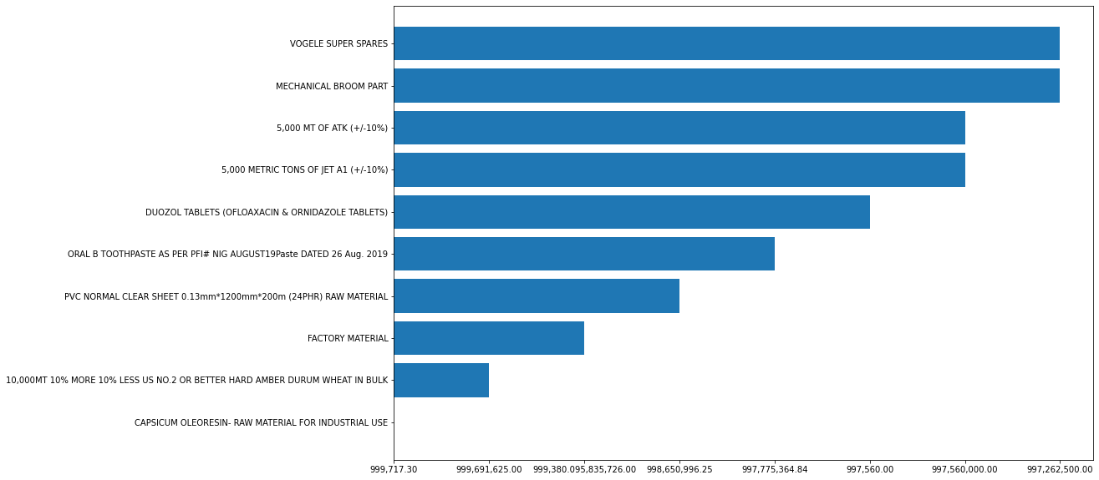

Visuals & Relationships
Fig1. Major importers
Fig2. Top ten import items Vs FOB(naira) Value

Slide 5
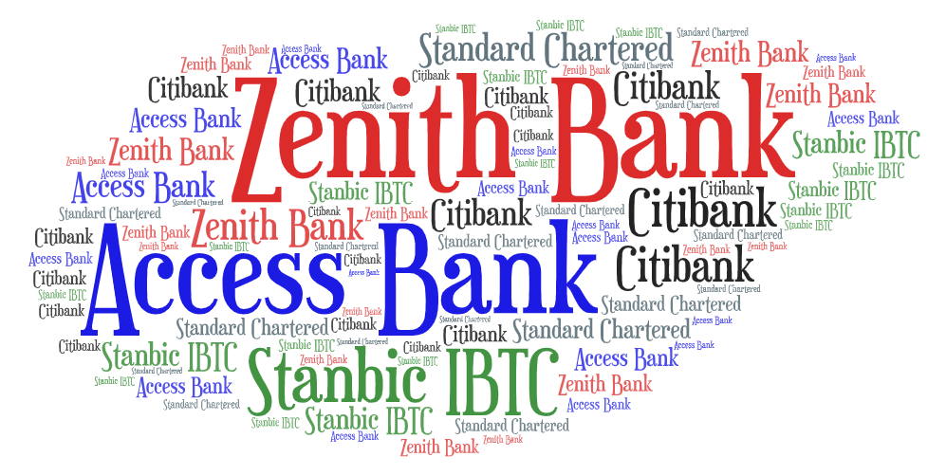

Visuals & Relationships Cont.
Thank You
Fig 3. Top 5 Banks that funded the most imports

